Slide 1


考古学における幾何形態測定学
Geometric Morphometrics and Archaeology
(Workshop One)
Dr Christian Steven Hoggard (University of Southampton)
CSHoggard
#StayHomeButStudy

Slide 2
Welcome!
Find the workshop materials／資料を見つけよう https://github.com/CSHoggard/-workshopjapan2020
Immediate feedback? Zoom (emojis and chat) その場の返信・反応は?
Questions? Slack and Google Document 質問は?

Slide 3
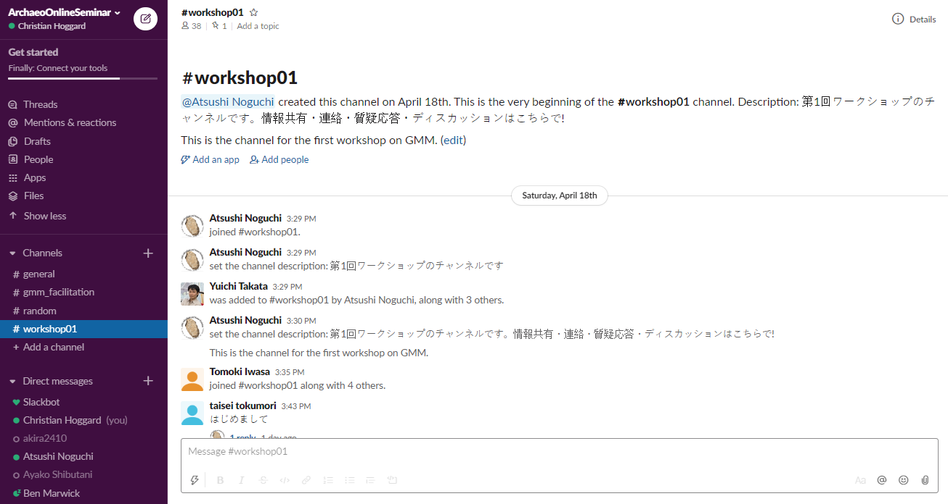

Slide 4
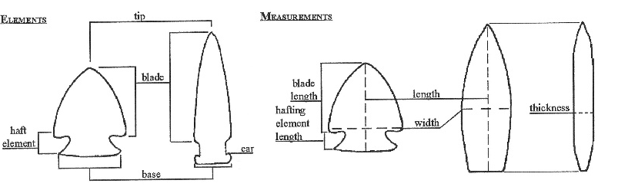
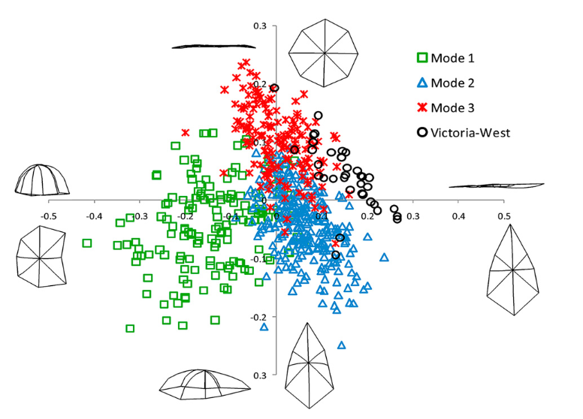
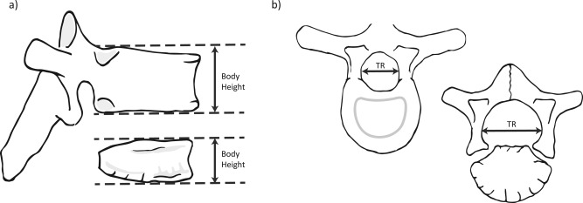

Slide 5
What is shape?

Slide 6
Shape as… かたちとは…
“In general terms, the shape of an object, dataset or image that can be defined as the total of all information is invariant under translation, rotation, and isotropic rescalings”
「かたち」とは、「変換、回転、等方的な拡大縮小によっても不変なすべての情報の合計」
Small (1996: 6)
Small, C. (1996). The statistical theory of shape. New York: Springer.

Slide 7
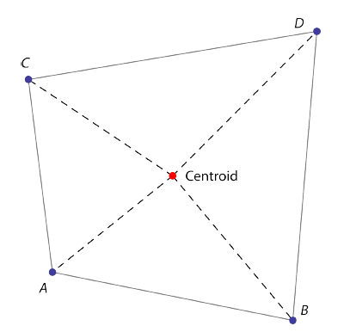

Size as… サイズとは…
The…
Length of an object?
Weight of an object?
Volume of an object?
Centroid size: square root of the summed squared lengths of the dashed lines
セントロイド・サイズ＝√破線の平方距離の合計
Mitteroecker, P., Gunz, P., Windhager, S., Schaefer, K. (2013). A brief review of shape, form, and allometry in geometric morphometrics, with applications to human facial morphology. Hysterix, the Italian Journal of Mammalogy. pp. 59-66.

Slide 8
Shape + Size = Form
かたち ＋ サイズ ＝ 形態

Slide 9
Morphometrics 101
First coined by Professor of Zoology (UCD) Robert Blackith in 1957
Quantitative study of shape, shape variation and shape covariation かたち、その変化・共変動の定量的研究
Two types of morphometric studies:
Traditional morphometrics (length measurements, angles, ratios…) 伝統的形態測定学（距離計測・角度・比...）
Geometric morphometrics or GMM (landmarks, outlines, curves, surfaces…) 幾何形態測定学（ランドマーク・アウトライン・曲線・サーフェイス...）
Note: Geometric Morphometrics ≯ Traditional Morphometrics

Slide 10
GMM advantages
GMM disadvantages
Powerful method of documenting shape change
Less information is lost in comparison to traditional measurements
Can easily be collected from a variety of methods (e.g. photographs and 3D models)
Abstraction and registration method permits an analysis of exclusively shape
Size is often removed which may be of biological importance (can be reintegrated)
Skill competency: often requires specific technical software and knowledge

Slide 11
Whether two assemblages are different in terms of their shape?
How is shape related to… size? time? raw material? hominin?
Whether differences correspond to a hypothesis or a model?
On an assemblage level: what is the mean or median shape?
With respect to size: is there an allometric relationship?
Over a series of sites: Is a network-based model of artefact production pertinent?
We can use GMM to determine…

Slide 12

A short history of geometric morphometrics… GMMの歴史

Slide 13
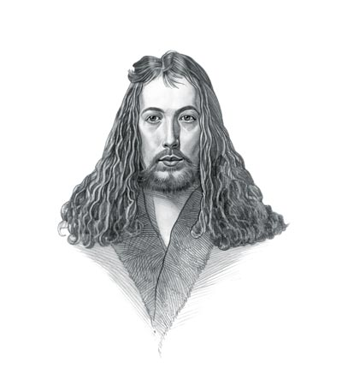
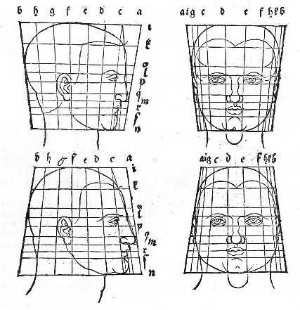
Albrecht Dürer (1471-1528)
Painter, printmaker and theorist
Founder of descriptive geometry working on helices, conchoids and epicycloids
Investigated the Delian Problem (doubling the cube)
Use of shape transformations in studying morphological differences in the human head
Dürer, A. (1528). De Symetria Partium in Rectis Formis Humanorum Corporum Libri, German edn. Patav. Nuremberg: Parisiis Curvi ac recti proportio.

Slide 14
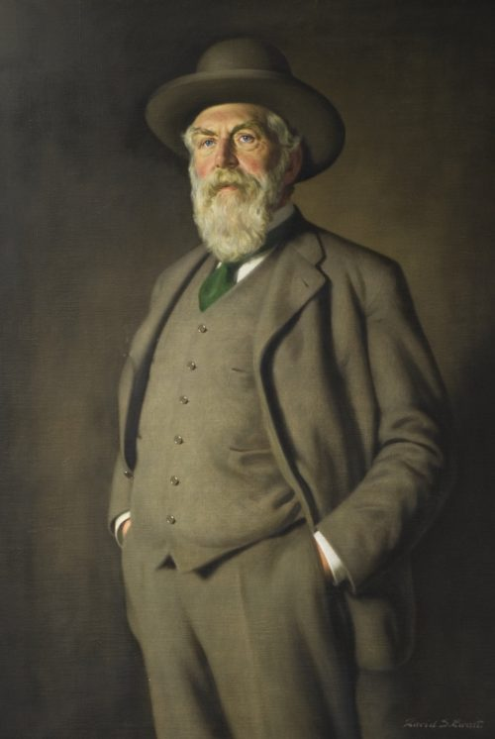
Sir D’Arcy Wentworth Thompson (1860-1948)
Biologist, mathematician and classics scholar
Famous for his quotes on the mathematical beauty of nature (inspiring Huxley, Turing, Lévi-Strauss and van der Rohe)
On Growth and Form (1917)
Fundamental book documenting the process of body structures formed in plants and animals
Emphasis on mathematical structures accounting for biological diversity

Slide 15
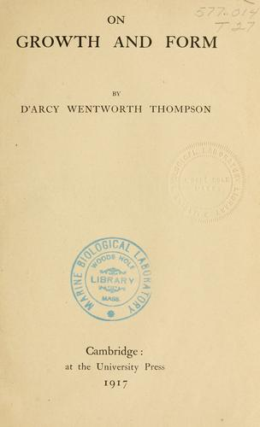
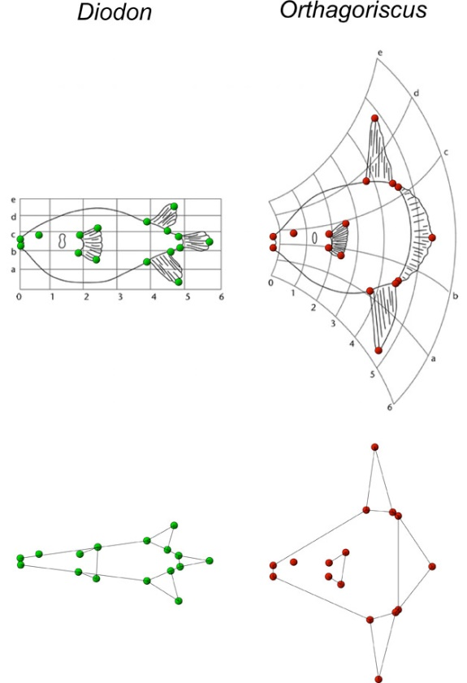
“The harmony of the world is made manifest in Form and Number, and the heart and soul and all the poetry of Natural Philosophy are embodied in the concept of mathematical beauty.”
Thompson, D.W. (1917). On Growth and Form. Cambridge University Press.

Slide 16
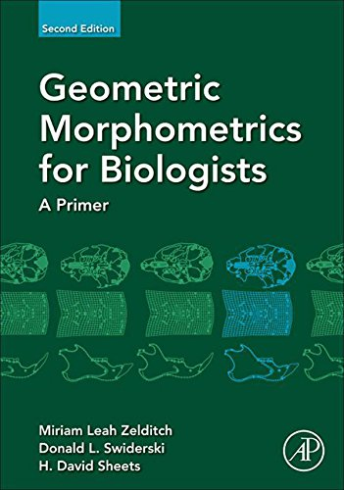
Towards a statistical framework
From the 1960s onwards...
Fred Bookstein (founder of modern-day GMM)
Dennis Slice
Miriam Zelditch
Norman MacLeod
Ian Dryden and Kanti Mardia
James Rohlf

Slide 17
10 Minute Break ／10分間の休憩×頭の整理
Questions? (Slack and Google Document) 質問はSlackかGoogleドキュメントへ
I’ll answer them following the break! 回答は休憩の後で!

Slide 18

How do we ‘do’ GMM? GMMの実践

Slide 19
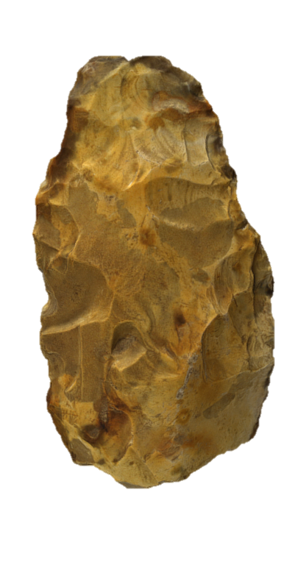
Stage 1: Dataset creation データの取得
Methods include…
CT scanning
Photogrammetry and structure from motion (SfM)
Microphotogrammetry
Microscribe
3D scanners (e.g. NextEngine)
Data obtained from drawings and photographs 実測図・写真でも可!
Note: Considered the error associated with each technique!

Slide 20
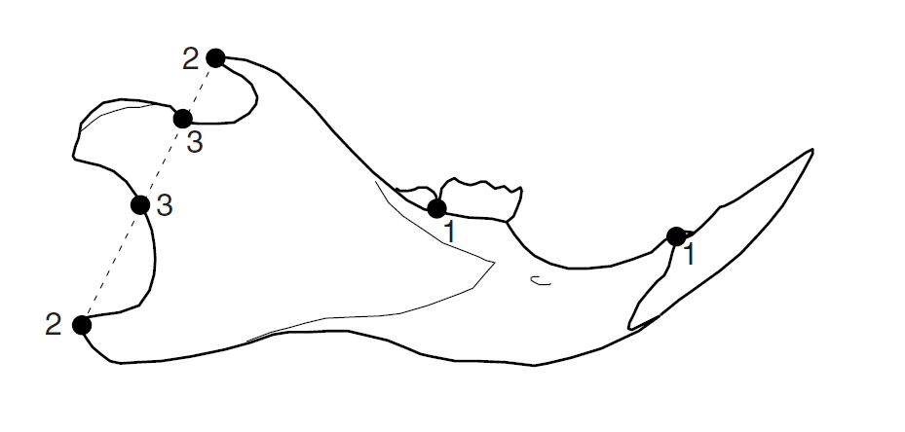
Stage 2: Landmark choice ランドマークの選択
Central to geometric morphometrics are landmarks
Landmark: coordinate point used to represent a shape and/or a homologous point on a structure
Quantifiable as Cartesian coordinates (x , y / z coordinates)
Variety of different ways of approaching what type of landmarks are necessary
Can be treated as individual points or converted (using various techniques) into curves and outlines
Claude, J. (2008). Morphometrics with R. Springer Publishing.

Slide 21
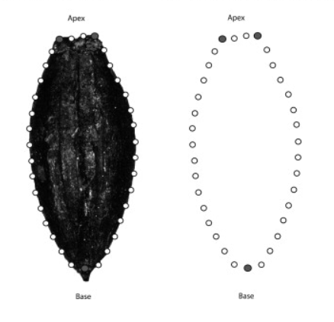
Stage 2: Landmark choice
Various types of landmarks ランドマークの種類
Type I: Homologous biological structures 相同な生物学的構造
Type II: Geometric definition e.g. greatest curvature 幾何学的な定義
Type III: Point with reference to another point 他の点にもとづく
A special example: semilandmarks セミ・ランドマーク
Placed using an algorithm
Equidistant and placed between one or two end-points
A special Type III landmark
See also sliding semilandmarks
Claude, J. (2008). Morphometrics with R. Springer Publishing.
Ros, J., Evin, A., Bouby, L. & Marie-Pierre, R. (2013). Geometric morphometric analysis of grain shape and the identification of two-rowed barley (Hordeum vulgare subsp. distichum L.) in southern France. Journal of Archaeological Science. 41.

Slide 22
Stage 2: Landmark choice
Landmarks should sample aspects which are of archaeological interest ランドマークは、考古学的に関心のある「かたち」の様相をサンプルとすべきであり、
Landmarks should be repeatable and identifiable on all examples (if possible) 可能であれば、すべての例で再現性があり、識別可能であり、
Landmarks should cover as much of the shape as possible 可能な限り多くの形状をカバーすることでき、
Sufficient as to not increase the ‘weighting of areas’ 特定の領域の重み付けを増加させないよなものであるべきであり、
Landmarks should always be plotted in the same order (otherwise the math wouldn’t work!) 常に同じ順序で配置されなければならない。
Claude, J. (2008). Morphometrics with R. Springer Publishing.
Ros, J., Evin, A., Bouby, L. & Marie-Pierre, R. (2013). Geometric morphometric analysis of grain shape and the identification of two-rowed barley (Hordeum vulgare subsp. distichum L.) in southern France. Journal of Archaeological Science. 41.

Slide 23
Stage 2: Landmark choice (some observations)
For Bioarchaeologists…
Greater number of points of morphological correspondence on specimens
Easier to study three-dimensional shape (orientation is less of an issue)
生物考古学者にとって…標本間で形態的に対応する点が多く、3次元のかたちの研究も容易（向きは問題にならない）
For Archaeologists studying non-biological material…
Greater creativity and thought is needed in orienting specimens and placing landmarks
Fewer case studies to compare geometric morphometric methodologies
考古学者にとって…対象の向きとランドマークの配置の検討が必要。事例研究はまだ少ない
For all archaeologists…
Fragmentation and sample size (representation of a population) need to be considered
すべての考古学者にとって…断片化とサンプルサイズ（対象は全体を反映しているか?）を考慮する必要がある

Slide 24
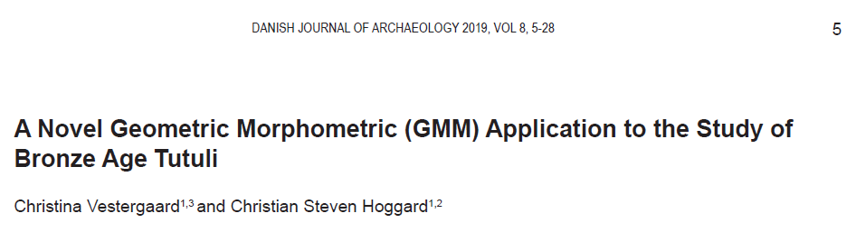

Slide 25
Stage 3: Landmark digitisation
ランドマークのデジタル化
Variety of different programs including:
TPS Suite (TpsUtil and TpsDig2)
R Packages (geomorph, StereoMorph, shape and GUImorph)
Landmark Editor (IDAV)
SlicerMorph
PhyloNimbus
Variety of different output files created including:
.tps*
.nts
.csv
.txt

Slide 26

GMM in the R Environment
With an increasing number of packages for creating, manipulating and analysing shape coordinates, and a more code-literate discipline, R is the ideal environment for archaeologists.
Permits a transparent, repeatable and reproducible GMM workflow.
Note: you may find certain stages easier to process outside of the R environment e.g. digitisation (and that is fine!)

Slide 27
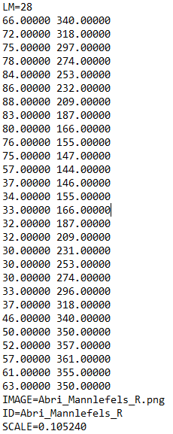
Stage 3: Landmark digitisation
Ask yourself…
Do all my specimens have the correct number of points?
Are all my landmarks in the correct order?
Are the ID labels correct?
Are they to scale? (For size-integrated analyses)
An example of a .tps file

Slide 28
10 Minute Break ／10分間の休憩×頭の整理
Questions? (Slack and Google Document) 質問はSlackかGoogleドキュメントへ
I’ll answer them following the break! 回答は休憩の後で!

Slide 29
Different forms of shape analysis かたちの分析のさまざまな方法
Landmark Analysis ランドマーク分析
Outline Analysis アウトライン分析
Semi-landmark Analysis
Fourier-based Analysis
Radial Fourier Analysis (RFA)
Elliptic Fourier Analysis (EFA)
Discrete Cosine Transform (DCT)
Eigenshape Analysis
Other methods e.g. Polynomial Curve Fitting
Workshop Two! （第2回で!）

Slide 30
Generalised Procrustes Analysis (GPA) 一般化プロクラステス分析
Also known as…
Procrustes Superimposition
Procrustes Analysis
Procrustes Fitting
Generalised Least Squares
Procedure to isolate shape from a number of sometimes related variables, specifically rotation, size and translation
「かたち」を関連するその他の変数－回転・サイズ・変換から分離する過程

Slide 31
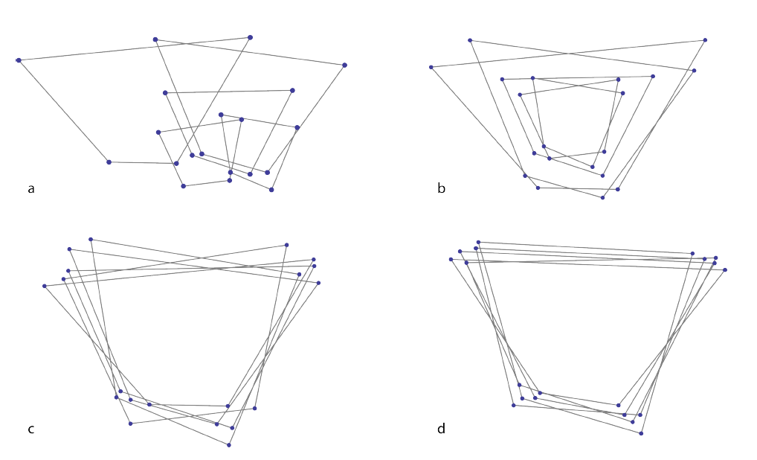
Generalised Procrustes Analysis (GPA)
The raw coordinates are…
Translated to a common centroid (A-B)
Scaled to the same centroid size (B-C)
Rotated to minimise the summed square distances between landmarks (C-D)
Outcome: Procrustes coordinates
The Procrustes coordinates = shape per se
セントロイドでの位置合わせ（a→b）
サイズ調整（b→c）
最小二乗距離法による回転（c→d）
Mitteroecker, P., Gunz, P., Windhager, S. & Schaefer, K. (2013). A brief review of shape, form, and allometry in geometric morphometrics, with applications to human facial morphology. Hysterix, the Italian Journal of Mammalogy. pp. 59-66.

Slide 32
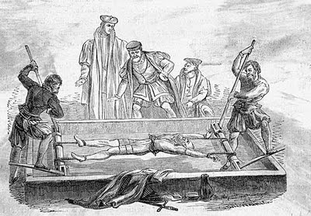
Who was Procrustes?
In Greek Mythology…
Procrustes was a son of Poseidon and lived on a sacred way between Athens and Eleusis.
There he had a bed, in which he invited every passer-by to spend the night, and where he set to work on them with his blacksmith's hammer, to stretch them to fit.
In later tellings, if the guest proved too tall, Procrustes would amputate the excess length; nobody ever fitted the bed exactly.
Procrustes continued his reign of terror until he was captured by Theseus, travelling to Athens along the sacred way, who "fitted" Procrustes to his own bed!

Slide 33
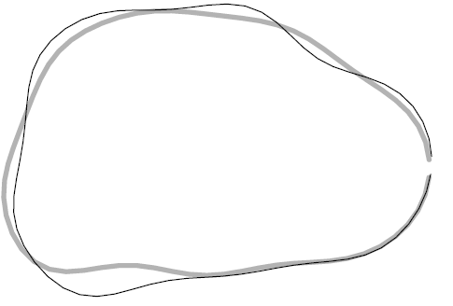
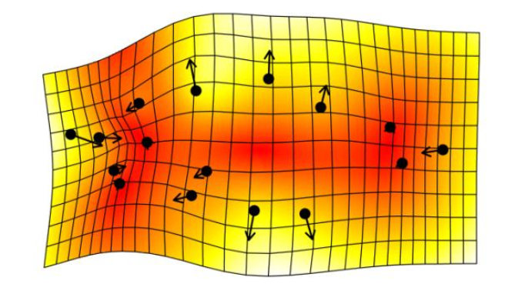
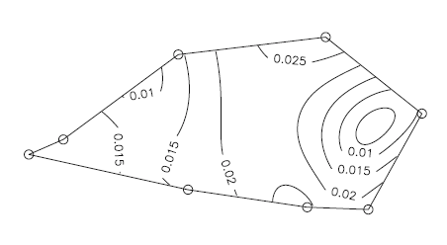
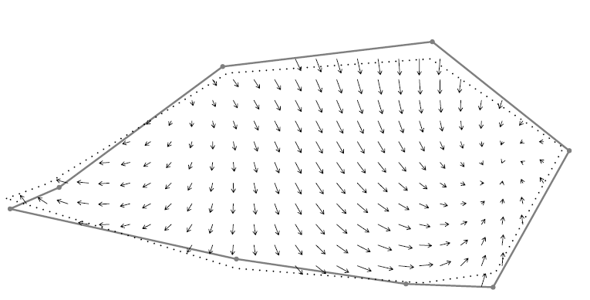
What can we do with these coordinates? #1: Visualising shape change 取得した座標で何ができるか1：視覚化
Represent shape change as…
Deformation grids
Principal strains
Lollipop sticks
Vectors
Contours
Claude, J. (2008). Morphometrics with R. Springer Publishing.

Slide 34
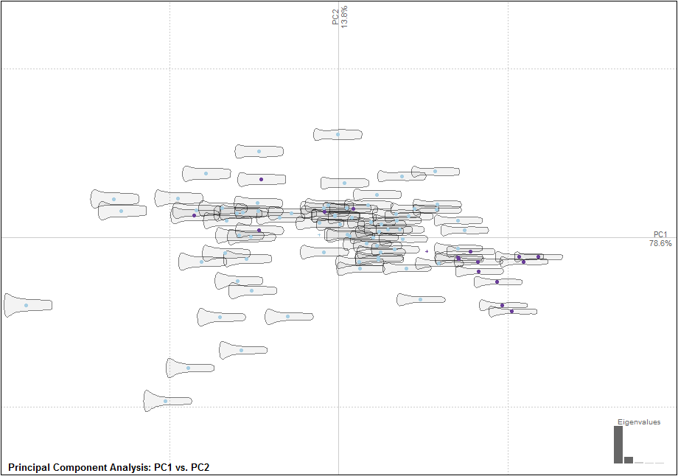
What can we do with these coordinates? #2: Explore differences in shape through a PCA
取得した座標で何ができるか2：主成分分析
PCA = Principal Component Analysis
Often the first method of analysis
Every point = landmark configuration
Mean shape = axis origin
Principal axes = sources of theoretical shape change
The scores produced are often used for further analysis
Hoggard, C.S., Lauridsen, L. and Witte, K.B. (2019). The Potential of Geometric Morphometrics for Danish Archaeology: Two Case Studies. Arkæologisk Forum, 40: 30-42. (http://www.archaeology.dk/16738/Nr.%2040%20-%202019). OSF: https://osf.io/en5d2/

Slide 35
What can we do with these coordinates? #3: Explore group differences through DA 取得した座標で何ができるか3：判別分析
DA = Discriminant Analysis (or Canonical Variate Analysis)
Examine the success with which a priori classifications can be distinguished through maximum-group separation.
Landmark configuration vs. PCA scores.
Creation of a training dataset to test unknown knowns.
Initial percentage = separation success on group data
Jack-knifed percentage (leave-one-out cross validation)
Determines success with which an artefact can be categorised solely on its shape
Vestergaard, C. and Hoggard, C.S. (2019). A Novel Geometric Morphometric (GMM) Application to the Study of Bronze Age Tutuli. Danish Journal of Archaeology, 8: 5-28.

Slide 36
What can we do with these coordinates? #4: Conduct a Procrustes ANOVA / MANOVA (statistical exercise)
PCA and DA act as exploratory devices for looking at shape difference
MANOVA and Procrustes ANOVA provide a statistical framework for examining shape
Procrustes ANOVA: performed in Geomorph (with landmark data)
MANOVA: performed in Momocs (with landmark and outline data)
Null hypothesis: same populations / shape

Slide 37
What can we do with these coordinates? #5: Perform correlation and regression analyses
Useful for examining shape hypotheses involving quantitative data for example size.
Other possible variables:
Symmetry
Latitude
Response (logistic regression)
PCA scores can be fed in using the base::lm() function.
Hoggard, C.S., McNabb, J. and Cole, J.N. (2019). The application of elliptic Fourier analysis in understanding biface shape and symmetry through the British Acheulean. Journal of Paleolithic Archaeology, 2 (2): 115-133,

Slide 38
What can we do with these coordinates? #6: Perform cluster-based analyses
A useful method for examining a posteriori classifications.
Utilises Principal Component scores (generated from the PCA!)
A variety of different cluster analyses are available.
Momocs: Hierarchical Clustering
Rphylip: Parsimony / Maximum Likelihood (computationally intensive!)
Ivanovaite, L., Serwatka, K., Hoggard, C.S., Sauer, F. and Riede, F. (2012). All these fantastic cultures? Research history and regionalisation in the Late Palaeolithic tanged point cultures of Eastern Europe. European Journal of Archaeology.

Slide 39
A quick note on outline-based analyses アウトライン分析の概要
Useful for when homologous landmarks are difficult to place on a structure e.g. handaxes.
Advantages over landmark analysis (for certain outline methods):
Do not need the same amount of points for each artefact (many more will be necessary for more complex objects).
Do not need to start at exactly the same position.
One of the main outline-based methodologies: Elliptic Fourier Analysis (EFA):
Semilandmarks are fed through a series of parametric equations (grounded on sine and cosine functions) to produce coefficients which create curve.
Coefficients are examined similarly to the Procrustes Coordinates
Workshop 2: R Demonstration (through Elliptic Fourier Analysis) 第2回で実演します!

Slide 40
Concluding Remarks: Future Directions まとめと展望
Greater application of GMM in a variety of new (non biological) archaeologies さまざまな考古学資料への適用の拡大
Methodological applications: automisation (recording and landmarking) 手法の展開：記録・ランドマーク付与の自動化
Coding developments: towards a replicable, reproducible and Shiny GMM… プログラミング：複製可能で再現性のあるGMM
More powerful analytics: e.g. Bayesian and Machine Learning techniques
より強力な分析：ベイズ統計、機械学習...

Slide 41
Thank you for attending!

